Slide 1
PFC Deadlock NS-3 Simulation

Slide 2
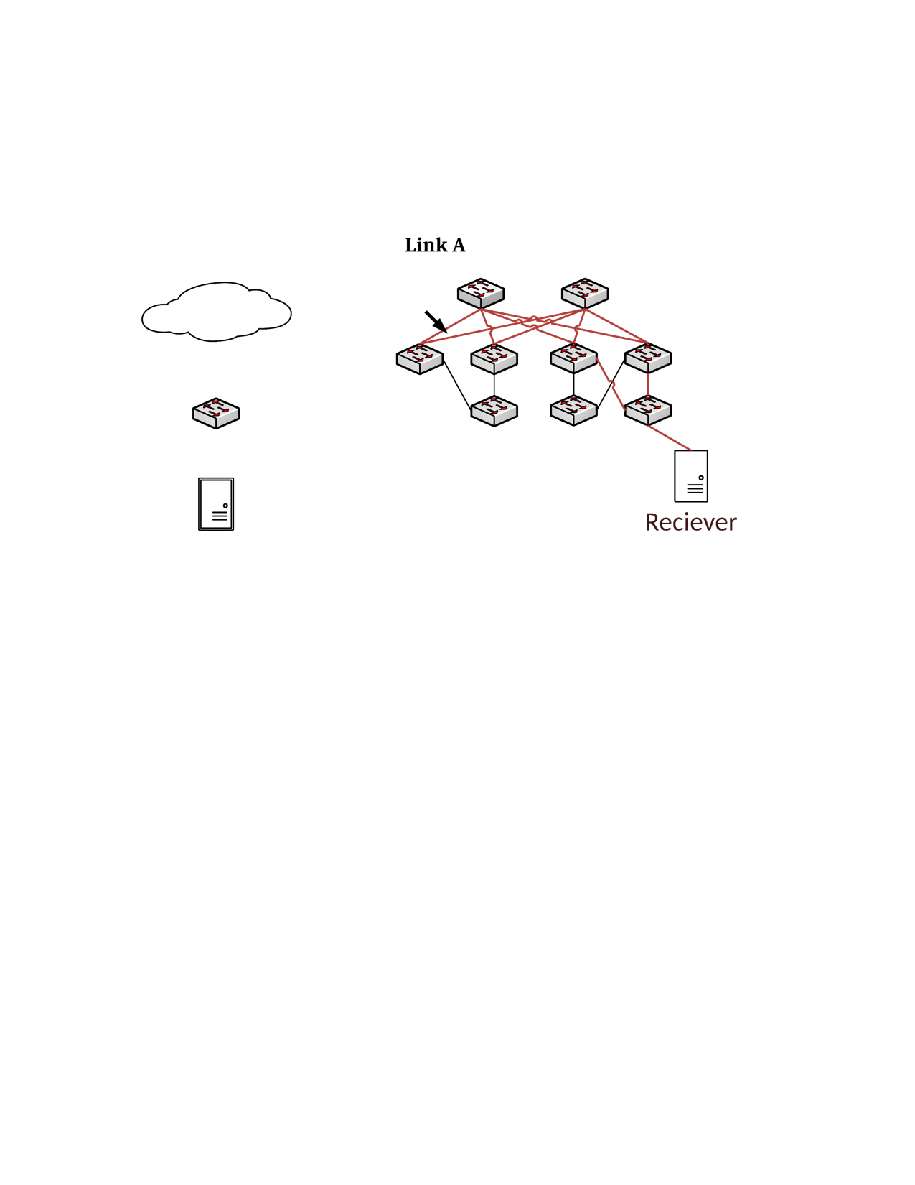
6
5
1
3
8
0
2
4
7
Three flows:
3 → 0 → 1 → 2 → 8
5 → 1 → 2 → 0 → 4
7 → 2 → 0 → 1 → 6
All 40Gbps links, greedy flows
Deadlock forms within 1.65ms

Slide 3
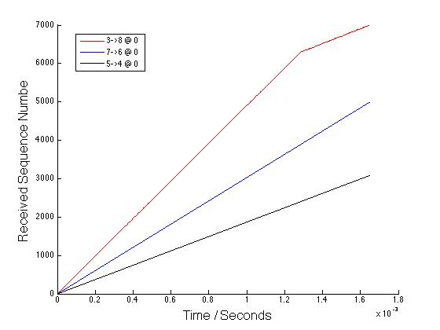
Three Flows at Switch 0

Slide 4
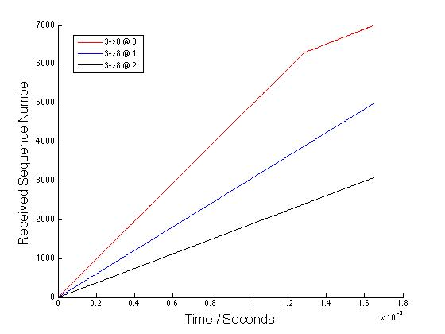
Flow 3→ 8 at Three Switches

Slide 5
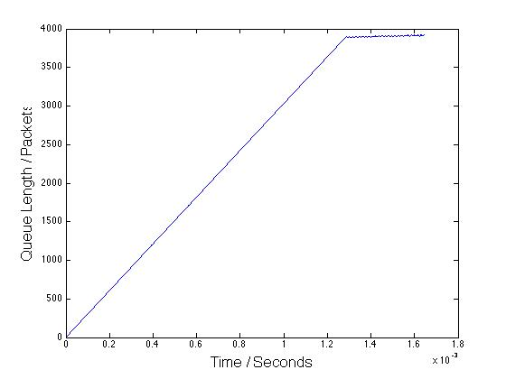
Queue Size at Switch 0

